Slide 1



Conflicting business models: How structural differences threaten aviation resilience – and what potential solutions might exist on the ANSP and airline side
Nuno Simões, NAV Portugal
Prof. Dr. Karsten Benz, University of Worms
Research Workshop
Single European Sky and Resilience in ATM
September 15-16, 2022 in Sofia/Bulgaria

Slide 2


Slide 3



Research Questions
How do Airlines and ANSPs may converge their levels of flexibility in capacity planning?
How to generate predictability and stability both within ANSP and airline operations?
How do we align objectives from both partners to optimize the overall benefit of the aviation industry and hence European economy?

Slide 4
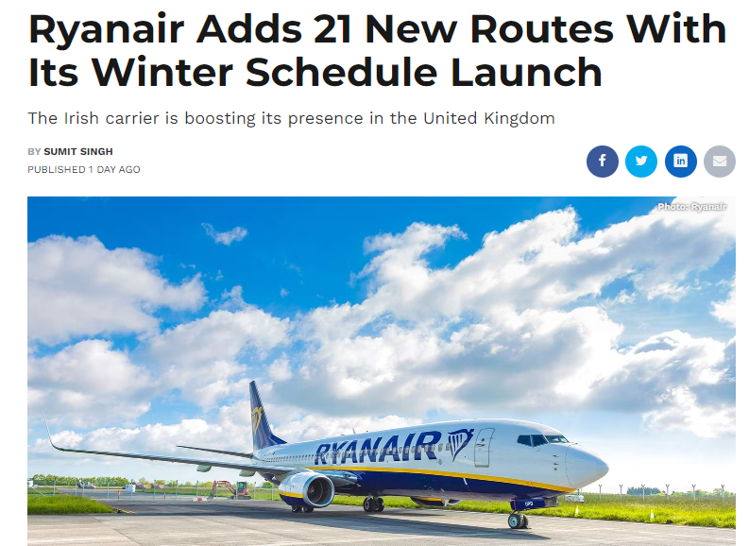
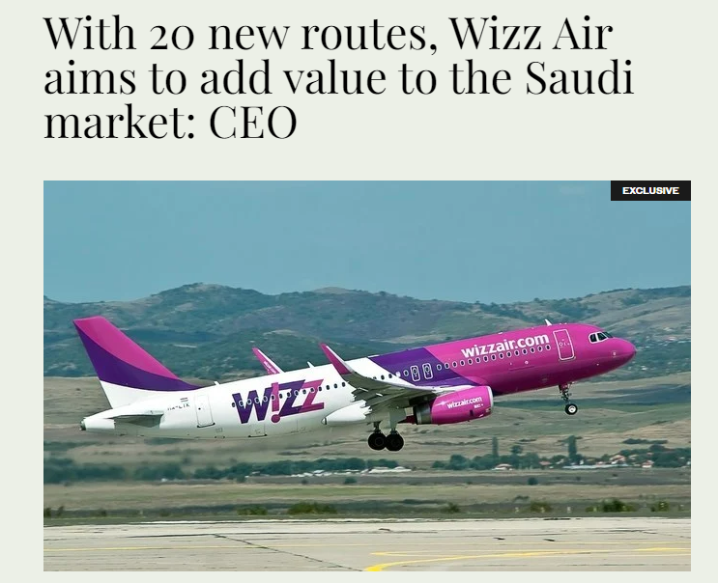
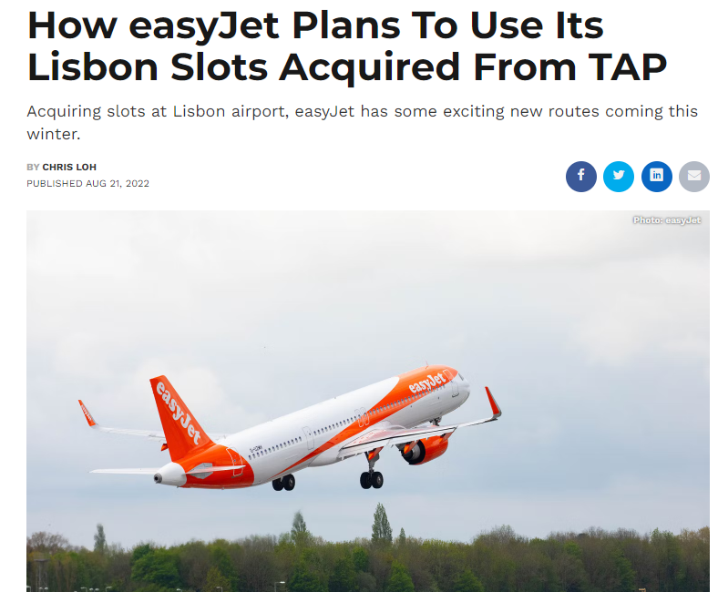
Market Dynamics Europe
Among the various factors that contributed to the crush, we must consider the different way Airlines and ANSPs plan, the latter being much more vulnerable to traffic volatility.
Can Airlines and ANSPs converge their levels of flexibility in capacity planning?

Slide 5

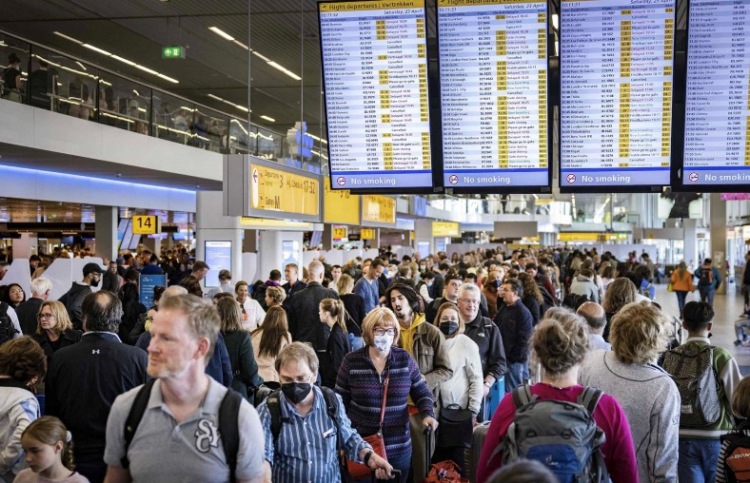
Market Dynamics Europe - Rebound Post Covid-19 in 2022
Rebound 2022:
Increased vaccination rates and the easing of travel restrictions have led to faster-than-expected recovery
Number of flight movements is picking up faster than the number of passengers
Low Cost Carrier are better positioned to make the most out of the rebound of the travel market
The rapid recovery in air travel has come up against a massive shortage in staffing at airports and airlines
ATFM delays occurred at significantly lower daily traffic levels than in 2019. ACCs did not deploy as much capacity as they had been able to allocate prior to the pandemic

Slide 6
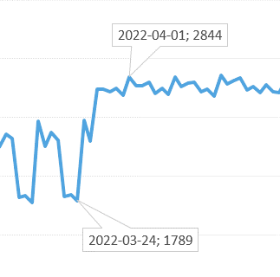

Market Dynamics Europe - Rebound Post-Covid 2022
At the latest with the start of the summer timetable, airline capacities were massively increased, even beyond the typical seasonality
Source: https://www.eurocontrol.int/Economics/DailyTrafficVariation-AOs.html

Slide 7
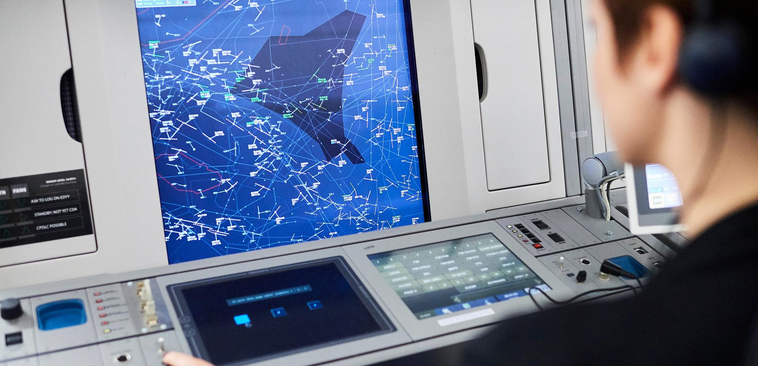
Business Model ANSP (Performance Model)
Objective and main source of revenue:
Provision of ATM/CNS to flights crossing through Flight Information Region(s)
Traffic forecasts are decisive factor to plan necessary capacity (staff, technology, etc.)
Regulation imposes SLAs (in terms of service provision)
and financial envelope (for reference period)
European Commission performance targets
(Safety, Capacity, Environment and Cost-Efficiency)
Business Model:
Base: Traffic forecasts and Performance targets
Plan:
  ATCOs
  other staff
  IT systems
  Investments
Financial Envelope
Traffic Forecast
Performance Targets
Performance Plan

Slide 8
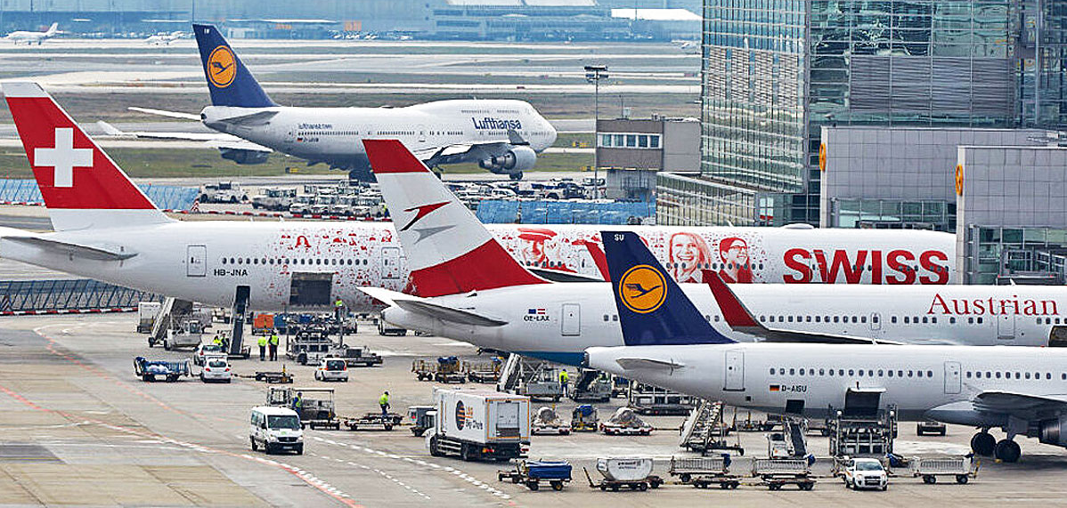
Business Model Airline (Demand Model)
Capacity decision
= Long-term commitment, ability to meet future demand, maintain competitiveness, affecting operating and capital costs
BASE:
Passenger traffic and Aircraft Movement forecasts
PASSENGERS FORECAST:
economic growth (GDP) and passenger yield
AIRCRAFT MOVEMENT FORECAST:
future trends in seating capacity and average load factors
BUSINESS MODEL
permanently minimising operating costs
maintaining a high degree of flexibility in terms of capacity
without making long-term commitments and without a sustained increase in fixed costs
with speed of reaction if travel flows change
(identify early changes in traffic flows, e.g. via Google Trends and Google Mobility)
With lead times for aircraft and crew rotations of 2 weeks in advance

Slide 9


Volatility and Resilience in ATM
Volatility
Increasing volatility in flight patterns, esp. in Europe
Causes:
  External shocks, such as the closing of Ukrainian and Russian airspace
  Seasonality
  Weather phenomena
  Changes in ATC service charges.
Predictability of traffic volumes is essential
Resilience
Fundamental property of the natural ecosystem that enables rapid recovery after disturbances.
ATM:
  Ability of ANSP to retain a certain level of the regular performance during a crisis
  Fully reach performance level fast afterwards
  Flexibility and scalability in case of demand changes by air space users

Slide 10
Converging planning flexibility of airlines with the performance model of ANSPs
Potential Solutions
A
A Binding agreement between AUs and the ATFM system (Airport Slot Mechanism)
B Allows ANSPs to incorporate a buffer in terms of capacity and costs able to accommodate volatility
C Performance Plan with built-in flexibility
D Enhanced Information Exchange ANSP and AU
B
C
D

Slide 11
Thank you for your attention!

